Slide 1
JQuery
By
K. Ramesh Kumar
ramesh.krishnan@bsil.com

Slide 2
Contents
  Introduction
  JSP Life Cycle
  Directives
  Web Application Structure
  JSP Element Types
  JSP Implicit Objects
  Read data from web.xml
  Attributes in JSP
  JSP Bean Tags
  Expression Language
  EL Implicit objects & EL operators
  Include and Forward Standard Actions

Slide 3
Contents…
  JSTL
  Error Handling
  Configure error pages in DD
  Creating TLD
  Custom Tags
  TLD Entries
  Simple Tag
  Include reusable contents using tag file
  Tag Handler API
  Classic Tag
  Simple Tag with body
  Classic tag with body
  Classic tag life cycle
  Examples

Slide 4
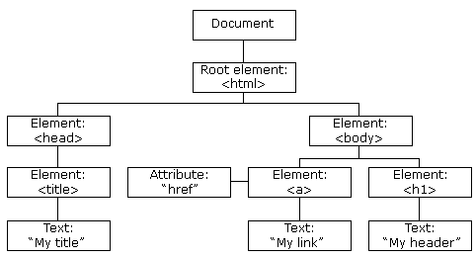
Introduction
jQuery is a JavaScript library specialized for changing web page documents on the fly.
HTML is a markup language that handles document structure.
CSS control the look and feel and position of the elements.
Every browser comes with a built-in JavaScript interpreter.
DOM version of html

Slide 5
jQuery makes the DOM less scary
jQuery is a JavaScript, but a much more approachable version.
jQuery controls the DOM much easier.
JavaScript way of code
  document.getElementsByTagName(“p”)[0].innertHTML=“Change the page.”;
jQuery way of code
  $(“p”).html(“Change the page.”);
The JavaScript interpreter doesn’t change the original HTML and CSS files. It makes changes to the DOM’s representation of the page in the browser’s memory.
jQuery function
  $( ) -- CSS selector, html and javascript object can go inside the parenthesis.

Slide 6
jQuery selector
jQuery selectors select elements to add behavior to those elements.
Element selector – Select all the elements in the HTML document.
Class selector – Select a grouping of elements belongs to particular class.
ID selector – Select a particular element.
jQuery element selector
  $(“h1”).hide();
jQuery class selector
  $(“.my_class”).slideUp();
jQuery ID selector
  $(“#my_id”).fadeOut();

Slide 7
jQuery version and installation
Production version
  Minified. Means that a bunch of unnecessary characters and white space have been removed.
It is optimized to run faster in a production environment but it is harder to read.
Development version
  Nicely spaced and much more readable.
  Anyone can dig into the jQuery code to change or even extend it.
  It is open source.
Install jQuery
  Download jQuery from http://jquery.com/

Slide 8
jQuery
Write less and do more.
DOM Manipulation
  The jQuery made it easy to select DOM elements, traverse them and modifying their content by using cross-browser open selector engine called Sizzle.
Event Handling
  The jQuery offers an elegant way to capture a wide variety of events.
  No need to clutter the HTML code itself with event handlers.
Ajax Support
  Supports to develop a responsive and feature-rich site using Ajax technology.

Slide 9
jQuery
Animation
  Plenty of built-in animation effects available.
Light weight
  Light weight library – 19 KB in size ( Minified and gzipped )
Cross Browser Support
  Works well in IE6.0+, FF2.0+, Safari 3.0+, Chrome and opera 9.0+
Latest technology
  jQuery supports CSS3 selectors and basic XPath syntax.

Slide 10
Using jQuery library and its library functions
If you want an event to work on your page, you should call it inside the $(document).ready() function.
DOM is loaded before the page contents are loaded.
Light weight
  Light weight library – 19 KB in size ( Minified and gzipped )
Cross Browser Support
  Works well in IE6.0+, FF2.0+, Safari 3.0+, Chrome and opera 9.0+
Latest technology
  jQuery supports CSS3 selectors and basic XPath syntax.

Slide 11
jQuery function
jQuery function used to select elements from an HTML page to manipulate.
$ shortcut is the replacement for the jQuery function.
The jQuery function can handle selectors, straight HTML, and even JavaScript objects.
Selectors
jQuery selects elements the same way CSS does: with selectors.
Fade effect functions
FadeIn, FadeOut, FadeTo, and FadeToggle.
Can fade in all kinds of elements from text to images and more.
Control the speed of your fade effect by putting a time( in milliseconds) with fade effect functions.

Slide 12

ID and Class
 | Class | ID
Uniquely identify a single element on the page
Can identify one or more elements on the page
Can be used by a single JavaScript method, cross-browser, to identify an element
Can be used by CSS to apply style to elements
More than one of these can be applied to an element at the same time

Slide 13
Why is the <script> tag at the bottom of the page before the </body> tag?
Scripts block parallel downloads in the browser.
Images from different servers can be downloaded more than two at a time, but once your browser encounters a <script> tag, it can no longer download multiple items in parallel.
Place scripts at the bottom will speed up your page load time.

Slide 14
Pass “*” into the jQuery wrapper to get all the elements.
Descendant selectors
  $(“div p”)
  $(“div div p”)
  $(“div p#my_para1”)
$(this) – Selects the “current” element
.append – Inserts the specified content into the DOM
.remove – Takes elements out of the DOM

Slide 15
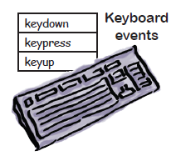
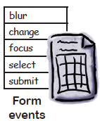
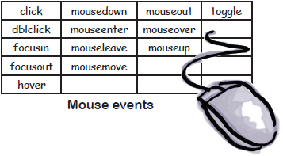
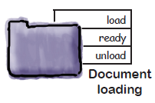
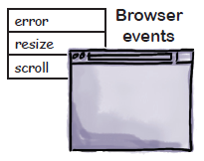
Triggering Events
Events are part of the DOM.
Events can be triggered by a wide variety of things on any given page.

Slide 16
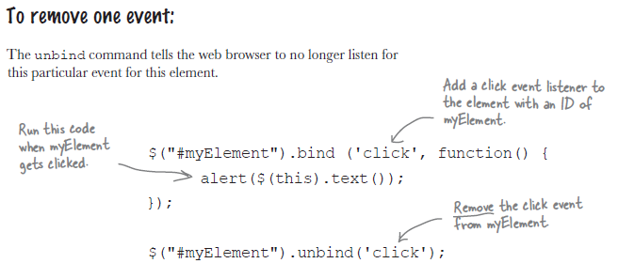
Handler Function
A handler function is a block of code that runs when the event is fired.
jQuery dealt with an events based on the browser.

Slide 17
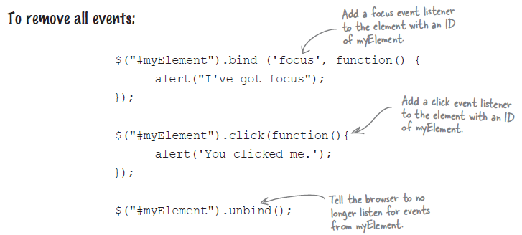
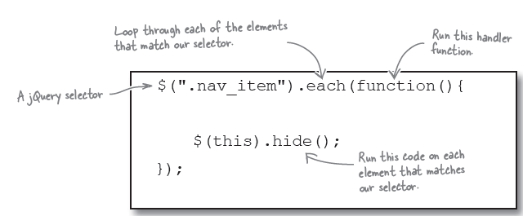
Looping through the elements

Slide 18
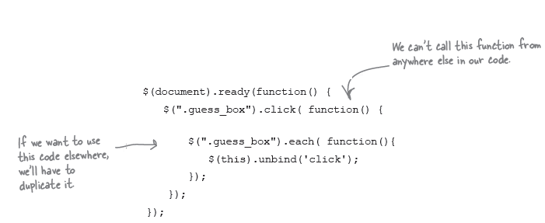
Anonymous function
Anonymous, or self-executing, functions don’t have a name.
They get called immediately when they’re encountered in the code.

Slide 19
Anonymous function
Anonymous, or self-executing, functions don’t have a name.
They get called immediately when they’re encountered in the code.

Slide 20
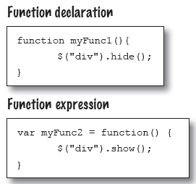
Named Functions as event handlers
We can use custom functions as event handlers and call them directly from our code.
Call a function from our code
  myFunc1();
Call a function as a handler function
  $(“#myElement”).click(myFunc2);

Slide 21
Static method in jQuery
Method associated with the jQuery library.
Call this method with jQuery name or its shortcut($)
Ex:
  if($.contains(this, document.getElementById("has_discount") ) ) {
  ----
  ----
  }
  Difference between remove and detach
  remove and detach both take elements out of the DOM.

Slide 22
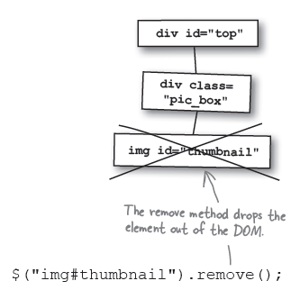
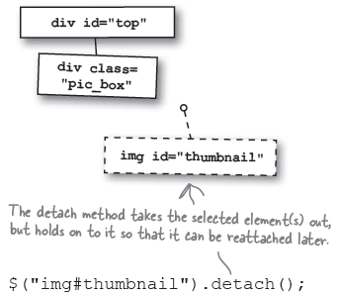
Remove Detach

Slide 23
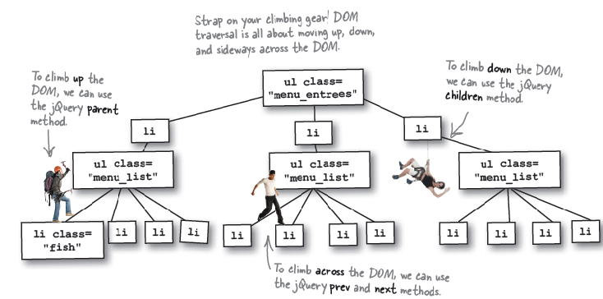
Swinging through the DOM tree
Method Chaining
Method chaining allows us to manipulate and traverse our pages in a more effective way.
Ex:
${“.fish”).parent().parent();

Slide 24
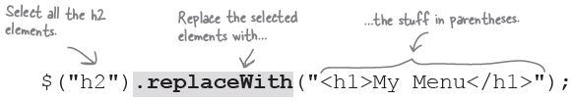
Storing elements from jQuery
replaceWith
The replaceWith method allows you to replace selected element(s) with new ones.

Slide 25
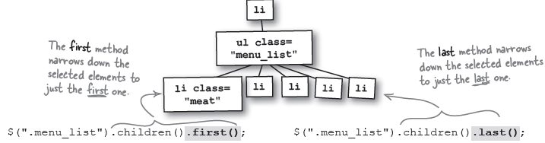
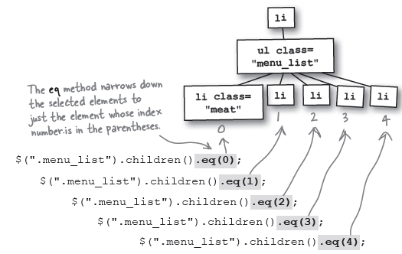
Filter methods to narrow selections ( first, last, eq, slice, filter, not )

Slide 26
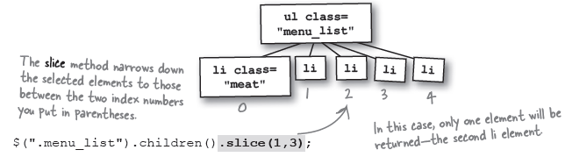
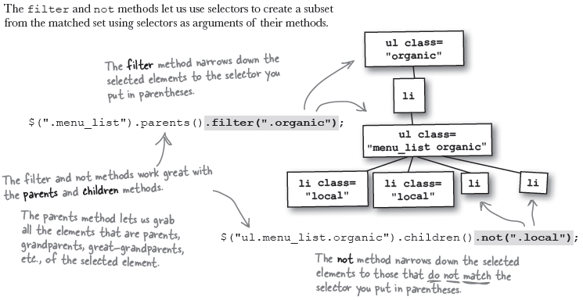

Slide 27
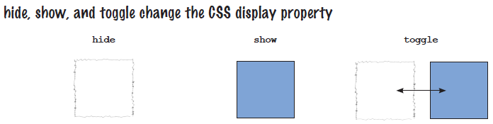
jQuery Animation and Effects
Browser layout engine
Browser layout engine interprets the HTML and CSS code and displays it in the browser’s view port.
CSS display properties
Browser | Layout Engine
Chrome | Webkit
Safari | Webkit
Firefox | Gecko
Microsoft Internet Explorer | Trident

Slide 28
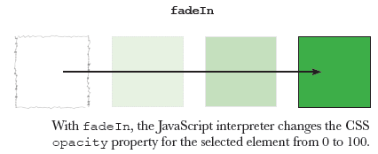
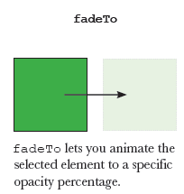
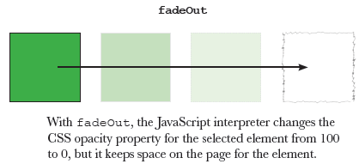
Fade Effects

Slide 29
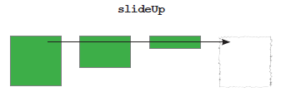
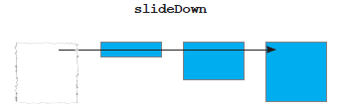
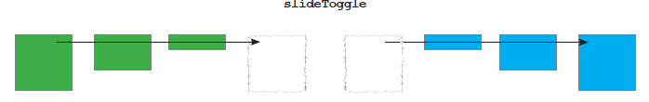
Fade Effects

Slide 30
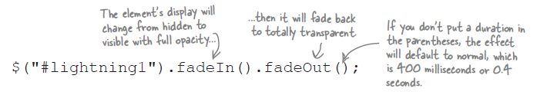


Combining effects with method chains
Motion Effects
Scale Effects

Slide 31
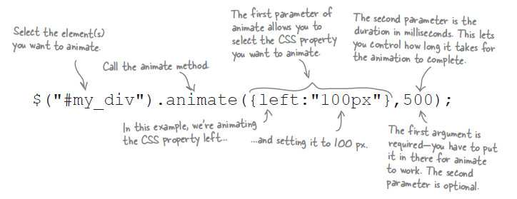
Animate method

Slide 32
Stopping Animation
Stop animation globally
$.fx.off = true;
Stop current running animation
When .stop() is called on an element, the currently-running animation (if any) is immediately stopped.
Ex:
  // Start animation
  $( "#go" ).click(function() {
  $( ".block" ).animate({ left: "+=100px" }, 2000 );
  });
  // Stop animation when button is clicked
  $( "#stop" ).click(function() {
  $( ".block" ).stop();
  });

Slide 33
Z-index
The z-index property specifies the stack order of an element.
An element with greater stack order is always in front of an element with a lower stack order.
Stop current running animation

Slide 34
ALL scriptlet and expression code lands in a service method.
Variables declared in a scriptlet are always LOCAL variables.
Scriptlet is just plain old java.
We can declare both static and instance variables and methods using declaration.
Ex:
Variable Declaration
<%! int count=0; %>
Method Declaration
<%! int add(int a,int b) {
return a+b;
}
%>
Note: Anything between the <%! And %> tag is added to the class outside the service method.

Slide 35
JSP Implicit Objects
With implicit objects, we can write a JSP knowing that your code is going to be part of a servlet.
All of the implicit objects map to something from the Servlet/Jsp API.
API | Implicit Object
JspWriter | out
HttpServletRequest | request
HttpServeletResponse | response
HttpSession | session
ServletContext | application
ServletConfig | config
JspException | exception
PageContext | pageContext
Object | page

Slide 36
Comments
Java Comment
// or /* */ → It will pass to the generated servlet file.
<!– HTML comment --> The container just passes this straight on to the client, where the browser interprets it as comment.
<%-- JSP comment --%>
This is the comment for the jsp code. The browser hide the jsp comments from the client view.

Slide 37
JSP Life Cycle Methods
jspInit()
This method is called from the servlet’s init() method.
You can override this method.
jspDestroy()
This method is called from the servlet’s destroy() method. You can override this method.
_jspService()
This method is called from the servlet’s service method. It runs in a separate thread for each request.
The Container passes the Request and Response objects to this method.
Note:
underscore in front of the name means you can’t override.

Slide 38
Translation and compilation happens only once
When you deploy a web app with a JSP, the whole translation and compilation step happens only once in the JSP’s life.
Once it’s been translated and compiled, it’s like any other servlet.
Once that servlet has been loaded and initialized, the only thing that happens at request time is creation or allocation of the thread for the service method.
Only the first client to ask for the jsp takes a big hit.
Most container vendors providing pre translation / pre compilation facility
It’s vendor-dependent and not guaranteed.

Slide 39
Read data from web.xml
  Web.xml entry
  <context-param>
  <param-name>officialMail</param-name>
  <param-value>ramesh.krishnan@bsil.com</param-value>
  </context-param>
  Jsp code snippet to read the data from xml file.
  <%
  ServletContext context = getServletContext();
  String mail = context.getInitParameter("officialMail");
  %>
  Email Address: <%= mail %>

Slide 40
Attributes in a JSP
 | In a Servlet | In a JSP (using Implicit objects)
Application | getServletContext().setAttribute(“foo”, resObj); | application.setAttribute(“foo”,resObj);
Request | request.setAttribute(“foo”,resObj); | request.setAttribute(“foo”,resObj);
Session | request.getSession().setAttribute(“foo”,resObj); | session.setAttribute(“foo”,resObj);
Page | --- | pageContext.setAttribute(“foo”,resObj);

Slide 41
Examples using pageContext to get and set attributes
Setting a page-scoped attribute
<% Float num = new Float(7.5); %>
<% pageContext.setAttribute(“foo”, num); %>
Getting a page-scoped attribute
<%= pageContext.getAttribute(“foo”);
Setting a session-scoped attribute using PageContext
<%= pageContext.setAttribute(“foo”, num, PageContext.SESSION_SCOPE); %>
Getting a session-scoped attribute using PageContext
<%= pageContext.getAttribute(“foo”, PageContext.SESSION_SCOPE) %>
Getting a application-scoped attribute using PageContext
<%= pageContext.getAttribute(“foo”, PageContext. APPLICATION_SCOPE) %>
Using the pageContext to find an attribute when you don’t know the scope
<%= pageContext.findAttribute(“foo”) %>

Slide 42
Scripting Invalid
The <scripting-invalid> tag disables scripting elements (scriptlets, java expressions or declarations ) for ALL JSPs in the application.
<web-app….>
…
<jsp-config>
<jsp-property-group>
  <url-pattern>*.jsp</url-pattern>
  <scripting-invalid>
  true
  </scripting-invalid>
</jsp-property-group>
</jsp-config>
</web-app>

Slide 43
JSP Bean Tags
Declare and initialize a bean attribute with <jsp:useBean>
<jsp:useBean id=“person” class=“foo.Person” scope=“request” />
<jsp:useBean id=“person” type=“foo.Employee” class=“foo.Person” scope=“request” />
jsp:useBean – Standard action
Id = identifier for the bean object
Class = declares the class type
Scope = attribute scope
Type = declares the reference type

Slide 44
Setting and Getting property with the bean
Setting particular property
<jsp:setProperty name=“person” property=“name” />
<jsp:setProperty name=“person” property=“name” value=“ram” />
Setting all the properties to the bean
<jsp:setProperty name=“person” property=“*” />
Getting the property to the bean
<jsp:getProperty name=“person” property=“name” />

Slide 45
Expression Language
EL expressions are ALWAYS within curly braces, and prefixed with the dollar sign.
${ employee.name }
The first named variable in the expression is either an implicit object or an attribute.
${firstThing.secondThing}
firstThing → EL implicit object or Attribute

Slide 46
EL Implicit Objects
pageScope
requestScope
sessionScope A map of the scope attribute
applicationScope
param
paramValues Maps of the request parameters
header Maps of the request headers
headerValues
cookie → Map of cookies
initParam → A Map of the context init parameters
pageContext → An actual reference to the pageContext
object
The pageContext implicit object is a bean – it has getter methods.
All other implicit objects are Maps.

Slide 47
Using the dot(.) operator to access properties and map values
If the expression has a variable followed by a dot, the left-hand variable MUST be a Map or a bean.
The thing to the right of the dot MUST be a Map key or a bean property.
And the thing on the right must follow normal java naming rules for identifiers.
Ex: ${ person.name }
person → Map or bean
name → Map key or bean property
We have to use [ ] operator to access list or arrays.

Slide 48
[ ] operator gives more options
If the expression has a variable followed by a bracket[ ], the left-hand variable can be a Map, a Bean, a List or an array.
If the thing inside the brackets is String literal with in quotes, It can be a Map key or a bean property, or an index into a List or array.
Ex: ${musicList[“something”] }
musicList → Map or Bean or List or array
something → Map key or bean property or array index or list index

Slide 49
Other EL Operators
Arithmetic
Addition : +
Subtraction : -
Multiplication : *
Division : / and div
Reminder : % and mod
Logical
And : && and and
Or : || and or
Not : ! And not
Relational
Equals : == and eq
Not equals : != and ne
Less than : < and lt
Greater than : > and gt
Less than or equal to : <= and le
Greater than or equal to : >= and ge
Note: There is no = operator in EL.

Slide 50
EL handles null values
EL is handling null values without throwing exceptions.
It will show the partial incomplete page instead of showing the user an error page.
In arithmetic, EL treats the null value as zero.
In logical expressions, EL treats the null value as false.

Slide 51
Include directive and <jsp:include> standard action
If we need to include same type of content into the more number of pages on your web site, we can use two types of include mechanisms available in jsp.
    Include directive
    <jsp:include> standard action
Ex:
<%@ include file=“Header.jsp” %> → jsp directive
<jsp:include page=“Header.jsp” %> → jsp action
The include directive inserts the SOURCE of “Header.jsp”, at translation time.
The <jsp:include> standard action inserts the RESPONSE of “Header.jsp”, at run time (request time).
The .jspf extension is a convention for JSP segments (fragments).
Ex: Header.jspf

Slide 52
Customizing the included content with <jsp:param>
Ex:
<jsp:include page=“Header.jspf” >
<jsp:param name=“subTitle” value=“This is sub title” />
</jsp:include>
jsp:include can have body while sending request parameters.
The included header ( Header.jspf ) that uses the new param like below.
${param.subTitle}
If the file is rarely changed and common code snippet can reuse across multiple pages ( e.g. headers and footers ) → use include directive.
Content changes at run time and files that change often. → use include action.

Slide 53
The <jsp:forward> standard action
We can forward from one jsp to another or from one jsp to a servlet or from one jsp to any other resource in our web app.
We can use conditions also with forward.
Ex:
<% if ( request.getParameter(“userName”)==“null” ) {
}
%>
<jsp:forward page=“Home.jsp” />
<% } %>
With <jsp:forward>, the buffer is cleared BEFORE the forward.

Slide 54
JSTL ( Java Standard Tag Library )
JSTL
<c:forEach>
<c:forEach> tag gives you a simple way to iterate over arrays and collections.
Ex:
<c:forEach var=“movie” items=“${movieList}” varStatus=“movieLoopCount”>
<tr>
<td> ${movieLoopCount.count}</td>
</tr>
<tr>
<td> ${movie} </td>
</tr>
</c:forEach>
movie → The variable that holds each ELEMENT in the collection. Its value changes with
each iteration.
movieList → The actual thing to loop over ( array, collection, map or a comma delimited string )
movieLoopCount.count → It gives the current value of the iteration counter.

Slide 55
Conditional jsp include with <c:if>
Ex:
<c:if test=“${num > 0} >
<jsp:include page=“process.jsp” />
</c:if>
<c:choose> with <c:when> and <c:otherwise>
Ex:
<c:choose>
<c:when test=“${average >= 75}”>
Distinction
</c:when>
<c:when test=“${average >= 60} and ${average <75}” >
First Class
</c:when>
<c:when test=“${average >= 50} and ${average <60}” >
Second Class
</c:when>
<c:otherwise>
Fail
</c:otherwise>
</c:choose>
Note:
If none of the <c:when> tests are true then <c:otherwise> runs as a default.
The <c:choose> tag is NOT required to have a <c:otherwise> tag.

Slide 56
c:set
Set comes in two flavors.
var and target
The var version is for setting attribute variables.
The target version is for setting bean properties or map values.
Each of the two flavors comes in two variations.
Setting an attribute variable var with <c:set>
With no body
<c:set var=“userLevel” scope=“session” value=“Admin” />
<c:set var=“userLevel” scope=“session” value=“${userRole}” />
With a body
<c:set var=“userLevel” scope=“session” >
Admin
</c:set>
Here the body is evaluated and used as the value of the variable.
If there is no variable named “userLevel”, this tag creates one.

Slide 57
Using <c:set> with beans and Maps
With no body
<c:set target=“${employee}” property=“salary” value=“25000” />
employee → bean or hashmap object
salary → bean property or map key
Here target should not be null
With a body
<c:set target=“${employee}” property=“name” >
${foo.name}
</c:set>
Note:
We never use both var and target attributes together.
Scope is optional and the default scope is page.
If the target expression is null, the container will throw exception.
The target is for putting in an expression that resolves to the real object.
If the target expression is not a map or bean, the container will throw exception.
If the target expression is bean, but the bean does not have a property that matches “property”, the container throws an expression.

Slide 58
<c:remove>
Ex:
<c:remove var=“userStatus” scope=“request” />
It will remove the attribute “userStatus”
The <c:import> JSTL tag.
<c:import url=“yahoo.com” />
It adds the content from the value of the url attribute to the current page, at request time.
We can include contents from outside the container.
The <c:url> for hyperlink needs
URL rewriting from a JSP
<a href=“<c:url value=‘/inputComments.jsp’ /> Click here </a>
This is the hyperlink with URL rewriting enabled.
It will add the extra session ID info to the URL
If you want pass parameters along with url, use <c:param>, It will take care of the url encoding.
Url rewriting and url encoding
<c:url value=‘/inputComments.jsp’ />
<c:param name=“firstName” value=“${first}” />
<c:param name=“lastName” value=“${last}” />
</c:url>

Slide 59
Error Handling
We have to show user friendly error messages to the user instead of stack trace information whenever exception occur in the page.
The designated error page (“errorPage.jsp”)
<html><body>
<strong> Error Occurred </strong> <br>
<%= exception.toString %>
</body></html>
The BAD page that throws an exception (“badPage.jsp”)
<%@ page errorPage=“errorPage.jsp” %>
<html><body>
<% int x = 10/0; %>
</body></html>
If anything goes wrong here, request is forwarded to the errorPage.jsp.

Slide 60
Configuring error pages in DD
You can declare error pages in the DD for the entire web application based on either the <exception-type> or the HTTP status <error-code> number.
Declaring a catch-all error page
This applies to everything in our web app-not just jsps.
We can override it in individual jsps by adding a error page attribute in a page directive.
<error-page>
<exception-type>java.lang.Throwable</exception-type>
<location>/errorPage.jsp</location>
</error-page>
Declaring an error page for a more explicit exception
This configures an error page that’s called only when there’s an Arithmetic exception.
<error-page>
<exception-type>java.lang. ArithmeticException</exception-type>
<location>/arithmeticError.jsp</location>
</error-page>
Any exception other than ArithmeticException will land at the errorPage.jsp

Slide 61
Declaring an error page based on an HTTP status code
This configures an error page that’s called only when the status code for the response is “404” (file not found).
<error-page>
<error-code>404</error-code>
<location>/notFoundError.html</location>
</error-page>
Error pages get an extra object : exception
An error page is essentially the JSP that handles the exception, so the container gives the page an extra object for the exception.
In a scriptlet, we can use a implicit object exception.
In EL, we can use ${pageContext.exception}.
Explicit Error page ( “errorPage.jsp” )
<% @ page isErrorPage=“true” %>
<html><body>
You caused a ${pageContext.exception} on the server. <br>
</body></html>

Slide 62
The <c:catch> tag.
We can do a kind of try/catch using the <c:catch> tag, to wrap the risky tag or exception.
<c:catch> serves as both try and catch.
Once the exception occurs, control jumps to the end of the <c:catch> tag body.
<%@ taglib prefix=“c” uri=“http://java.sun.com/jsp/jstl/core” %>
<%@ page errorPage=“errorPage.jsp” %>
<html><body>
  <c:catch>
  <% int x = 10/0; %>
  </c:catch>
</body></html>

Slide 63
Using the “var” attribute in <c:catch>
  <c:catch var=“myException”>
  <% int x = 10/0; %>
  </c:catch>
  <c:if test=${myException != null} >
  There was an exception : ${myException.message} <br>
  </c:if>
  Here, page scoped attribute “myException” is created and it holds the exception object.

Slide 64
Creating tld
Write a Java class with a public static method.
This is plain old java class.
Method should be public static and non-void return type.
Put the class file under the /WEB-INF/classes directory structure.
Write a Tag Library Descriptor (TLD) file.
The TLD provides a mapping between the java class that defines the function and JSP that calls the function.
Put the TLD file inside the /WEB-INF directory.
Name it with a .tld extension.
Put a taglib directive in the jsp.
The taglib directive is kind of like giving all our functions fully-qualified names.
We invoke the function by giving both the function name and TLD prefix.
Use EL to invoke the function.
${prefix:name()}

Slide 65
Custom tags
A tag library descriptor (TLD) file is an XML document that defines a tag library and its tags
The tag name and syntax
Tag has a name.
Eg:
<c:set>
c → prefix
set → tag name
We can use any prefix.
The tag name comes from the TLD.
Tag library URI
The URI is a unique identifier in the TLD.
It tells the container how to identify the TLD file with in the web app.

Slide 66
TLD Entries
xmlns:xsi="http://www.w3.org/2001/XMLSchema-instance“ → version of xml schema for jsp2.0.
<tlib-version>1.0</tlib-version> → version of taglib library.
<short-name>CWCTravel</short-name> → some tools can use this tag or we can use this as a tag prefix.
<uri>randomThings</uri> The unique name in the taglib directive.
<tag>
<description>random advice</description>
<name>advice</name>
<tag-class>foo.AdviceProcessor</tag-class>
<body-content>empty</body-content>
</tag>
description → optional
name → required → It is used to invoke from jsp
tag-class → required → contains logic
body-content → required
The container looks for match between the <uri> in the TLD and the uri value in the taglib directive.

Slide 67
<attribute>
<name>user</name>
<required>true</required>
<rtexprvalue>true</rtexprvalue>
</attribute>
JSP that uses the tag
<html><body>
<%@ taglib prefix=“cwctravel” uri=“randomThings” %>
Advisor Page <br>
<cwctravel:advice user=“${userName}” />
</body></html>
The method name is always doTag() in custom tags.
The <rtexprvalue> is especially important It tells us whether the value of the attribute is evaluated at translation or runtime.
If the <rtexprvalue> is not defined or false, we have to pass string value.

Slide 68
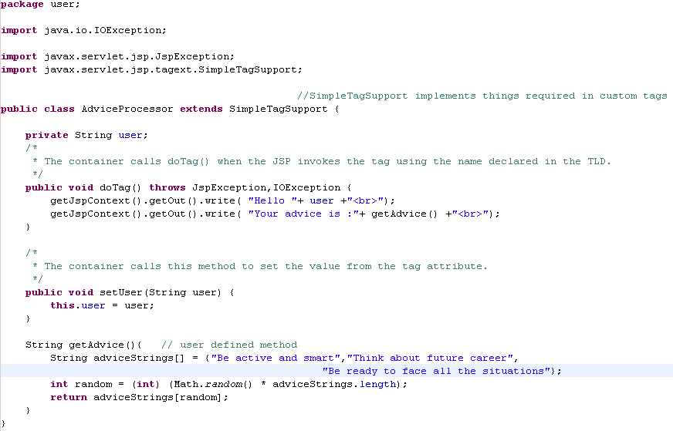
Java class that does the tag work

Slide 69
What can be in a tag body
<body-content>empty</body-content>
The tag must not have a body
<body-content>scriptless</body-content>
The tag must not have scripting elements ( scriptlets, scripting expressions and declarations )
It can have template text, EL, custom and standard actions.
<body-content>tagdependent</body-content>
The tag body is treated as plain text, so the EL is not evaluated and tags/actions are not triggered.
<body-content>JSP</body-content>
The tag body can have anything that can go inside a JSP.

Slide 70
Three ways to invoke a tag that can’t have a body
An empty tag
<cwctravel:advice user=“${userName}” />
A tag with nothing between the opening and closing tags.
<cwctravel:advice user=“${userName}”></cwctravel:advice>
A tag with only <jsp:attribute> tags between the opening and closing tags.
<cwctravel:advice>
<jsp:attribute name=“user”>${userName}</jsp:attribute>
</cwctravel:advice>

Slide 71
The New jsp2.0 way to map a taglib uri to a TLD file
No <taglib> entry in the DD.
The container automatically builds a map between TLD files and <uri> names.
Four places the container looks for TLDs.
    Directly inside WEB-INF
    Directly inside a sub directory of WEB-INF
    Inside the META-INF directory
    Inside a jar file
    that’s inside WEB-INF/lib
    Inside the sub-directory of META-INF
    Inside a jar file
    that’s inside WEB-INF/lib

Slide 72
Include Reusable contents using tag file
Simplest way to make and use a Tag File
Rename .jsp file to .tag file
Ex:
Header.jsp → Header.tag
Put the .tag file into the following folder structure.
WEB-INF → tags → Header.tag
Put a taglib directive ( with a tagdir attribute) in the JSP, and invoke the tag.
<%@ taglib prefix=“myTags” tagdir=“/WEB-INF/tags” %>
<html><body>
Welcome to blue star…
<myTags:Header />
</body></html>
Here, Header is the tag name ( Header.tag ).

Slide 73
Receiving parameter for the tag file
We can use attribute tag to receive the parameter for the tag.
Ex:
<%@ attribute name=“subTitle” required=“true” rtexprvalue=“true” %>
<strong> ${subTitle} </strong>
Inside the jsp that uses the tag.
<%@ taglib prefix=“myTags” tagdir=“/WEB-INF/tags” %>
<html><body>
Welcome to blue star…
<myTags:Header subTitle=“We are the masters in the travel and hospitality domain” />
</body></html>

Slide 74
Receiving big attribute value for the tag file
We have to use <jsp:doBody /> tag for receiving large attribute values.
Inside the tag file
<strong><jsp:doBody/></strong>
Inside the jsp that uses the tag
<%@ taglib prefix=“myTags” tagdir=“WEB-INF/tags” %>
<html><body>
<myTags:Header>
We are the masters in the travel and hospitality domains. We are providing best possible and accurate solutions. We have huge experience and expertise in these domains.
</myTags:Header>
</body></html>

Slide 75
Where the container looks for the tag files
Directly inside WEB-INF/tags
Inside a sub-directory of WEB-INF/tags
Inside the META-INF/tags directory
inside the a JAR file
that’s inside WEB-INF/lib
Inside the sub directory of META-INF/tags directory
  inside a JAR file
  that’s inside WEB-INF/lib
If the tag file is deployed in a JAR, there must be a TLD for the tag file

Slide 76
Skip page exception
SkipPageException shows everything upto the point of exception.
Ex:
The tag handler doTag() method.
public void doTag() throws JspException,IOException {
getJspContext().getOut().write( “Message from within doTag().");
getJspContext().getOut().write( “About to throw a SkipPageException");
if(thingsDontWork) {
throw new SkipPageException();
}
}
The Jsp that invokes the tag
<%@ taglib prefix=“myTags” uri=“simpleTags” %>
<html><body>
About to invoke a tag that throws SkipPageException <br>
<myTags:simple/> → The jsp is won’t execute after this point
<br>After tag invokation
</body></html>

Slide 77
Tag Handler API
<<Interface>>
JSPTag
// No Methods
<<interface>>
SimpleTag
<<interface>>
Tag
SimpleTagSupport
<<interface>>
IterationTag
<<interface>>
BodyTag
TagSupport
BodyTagSupport

Slide 78
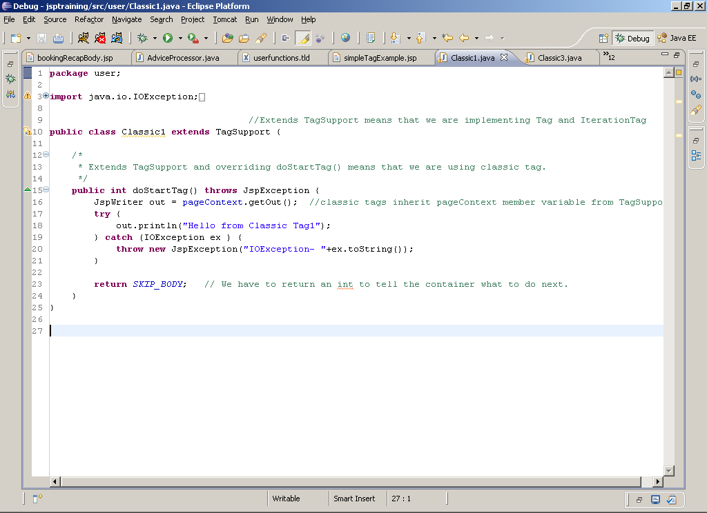
Classic Tag Handler

Slide 79
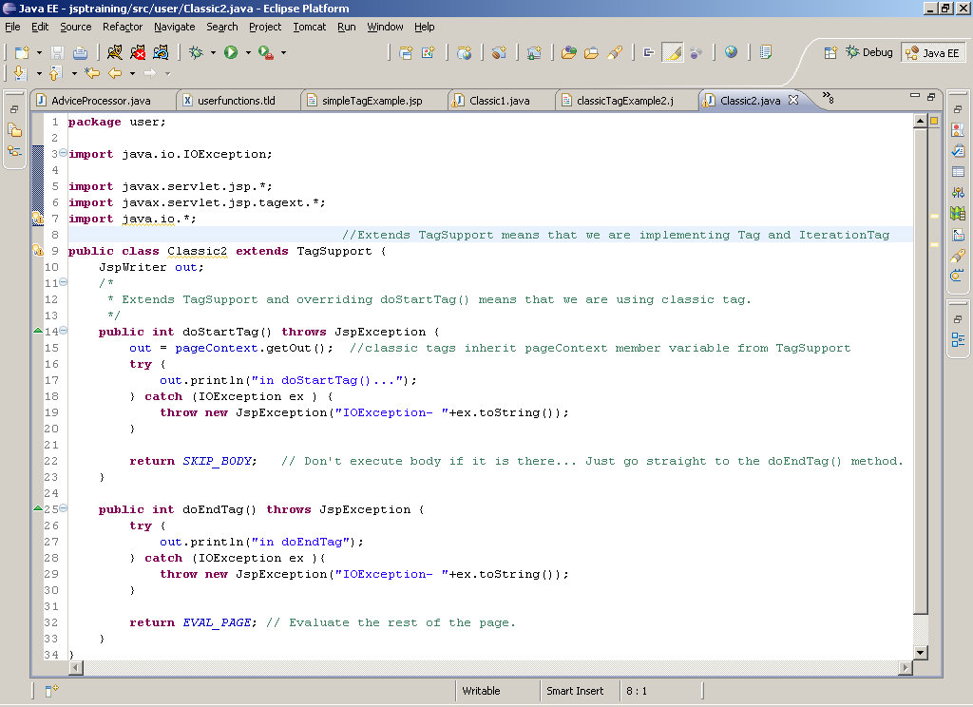
A classic tag handler with two methods

Slide 80
Simple tag with body
Simple tag bodies are evaluated when calling Invoke() method in the JSPFragment.
<html>
<body>
  <%@ taglib prefix="cwctravel" uri="randomThings" %>
  <cwctravel:simpleBody>
  This is the body from simple tag.
  </cwctravel:simpleBody>
</body>
</html>

Slide 81
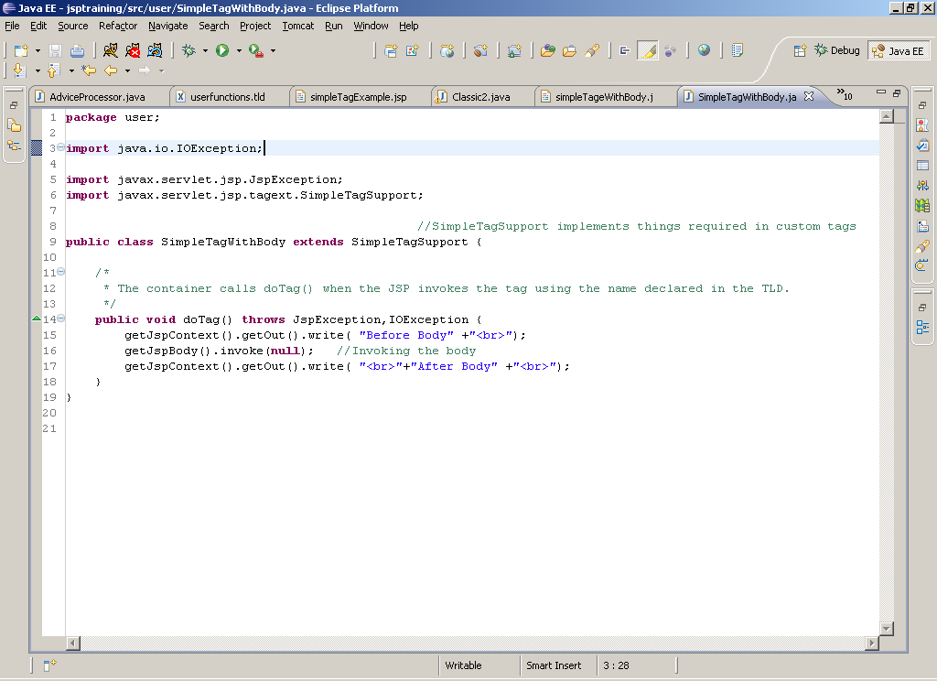
Simple tag with body

Slide 82
Classic tag with body
<html>
<body>
  <%@ taglib prefix="cwctravel" uri="randomThings" %>
  Classic Tag with body<br>
  <cwctravel:classicThree>
  This is the content inside tag body ( classic ).
  </cwctravel:classicThree>
  <br>This is from jsp after the tag invocation.
</body>
</html>

Slide 83
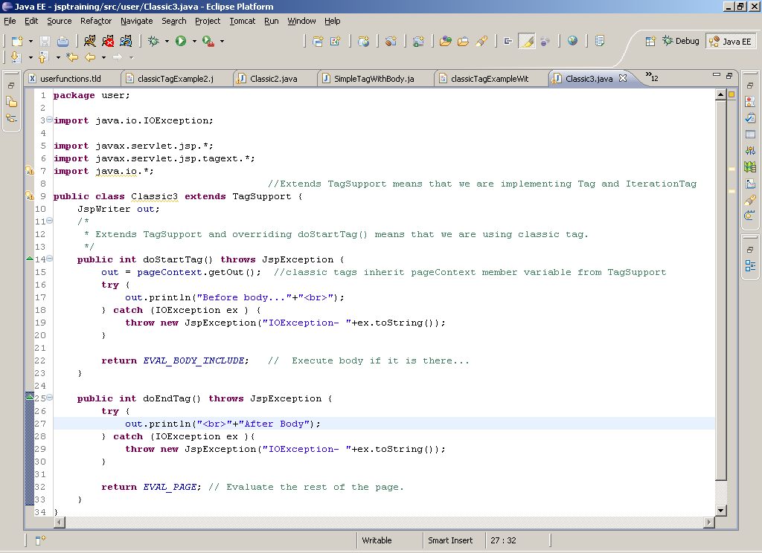
Classic tag with body

Slide 84
Classic tag life cycle
The doStartTag() and doEndTag() methods return an int.
That int tells the container what to do next.
The return values are represented by constants declared in the Tag and Iteration tag interfaces.
Possible return values when you extend TagSupport.
doStartTag()
SKIP_BODY
EVAL_BODY_INCLUDE
doAfterBody()
SKIP_BODY
EVAL_BODY_AGAIN ( Declared in IterationTag and others are from Tag )
doEndTag()
SKIP_PAGE
EVAL_PAGE

Slide 85
Classic tag life cycle
doStartTag()
return SKIP_BODY
return EVAL_BODY_INCLUDE
Evaluate Body
return EVAL_BODY_AGAIN
doAfterBody()
return SKIP_BODY
doEndTag()
return EVAL_PAGE
return SKIP_PAGE
Evaluate Page
DONE

Slide 86
THANK YOU

